Slide 1

At what cost?
At what cost?
The experiences of unpaid
mental health carers in Queensland
2023-2024

Slide 2


Areas for Action
Questions and ideas?
We produced our first statewide consultation report this year

Slide 3
What do mental health carers do?
What do mental health carers do?
Provide practical assistance
Provide emotional support
Advocate and navigate systems
Monitor, supervise and manage crises
Provide financial support
Build knowledge
and combat stigma
Make personal sacrifices
Encourage professional help and social connections
Create a stable environment

Slide 4
“Caring for someone experiencing mental illness is very isolating.
We are in permanent ongoing crisis management for our people.
Unrelenting crisis. Carers are life coaches, taxis, personal assistants,
personal hygiene coordinators, cleaner, maid, cook, nutritionists,
sleep behaviour managers, suicide watchers… Carers are helping people through poor executive functioning. We are the entertainment.
We are their everything. It is a lot of pressure on carers to be everything.”

Slide 5
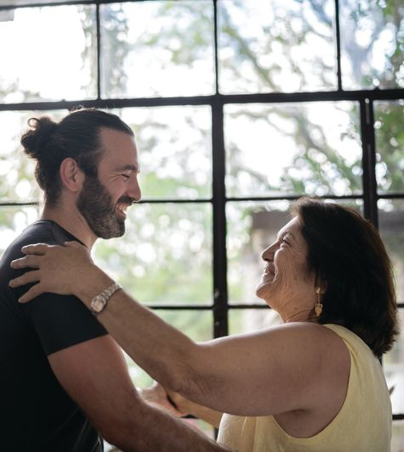
What do mental health carers do?
Challenges across mental health carers
Financial hardship
Impact on emotional wellbeing, mental health and physical health
Mental health system navigation and advocacy
Feeling excluded from care planning and decision-making
Stigma and social isolation
Struggling to get a break

Slide 6
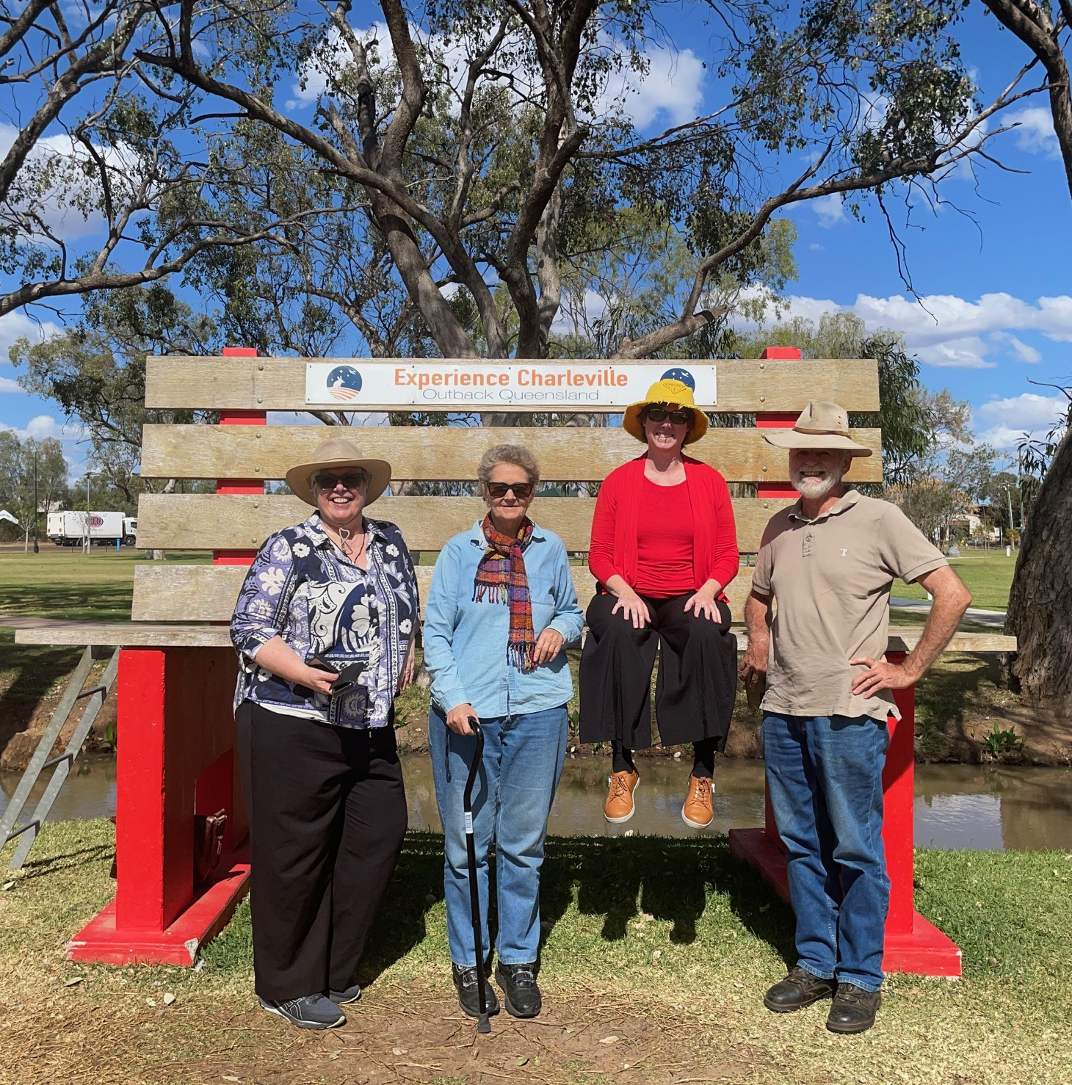
Why now?
Challenges for rural carers
Poor access to services and supports
Social isolation, stigma and privacy issues
Lack of consultation in admission and discharge processes
Lack of understanding of
First Nations caring practices

Slide 7
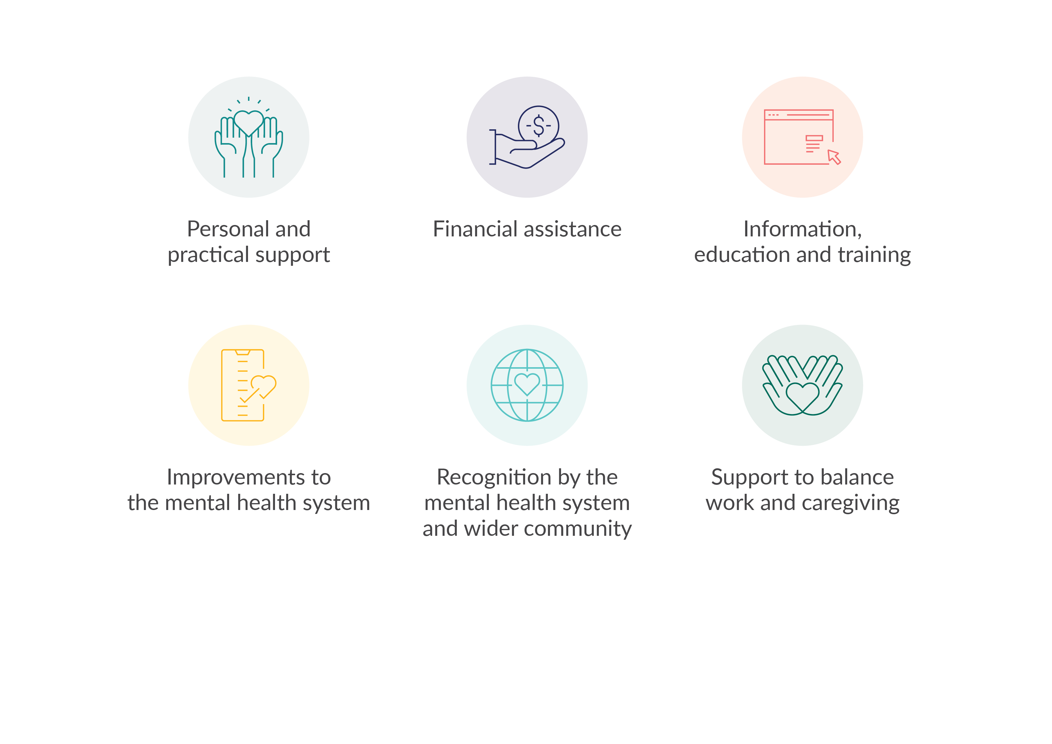
What’s needed?

Slide 8
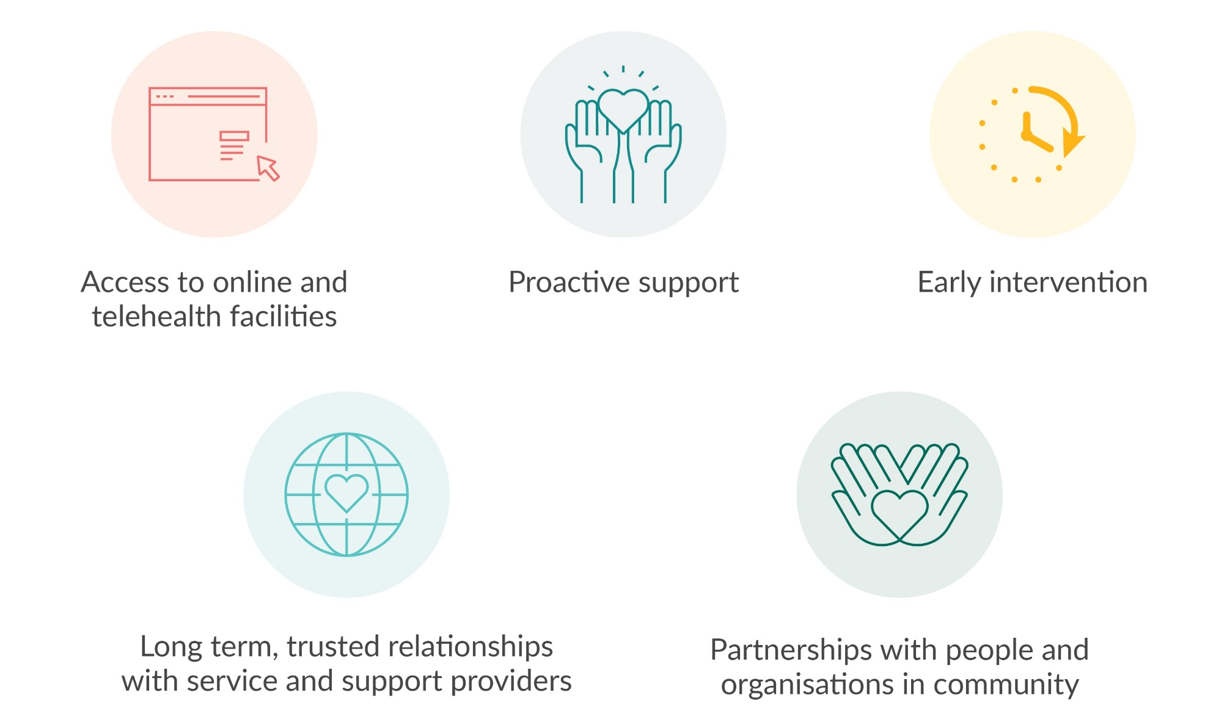
What’s needed in rural areas?

Slide 9
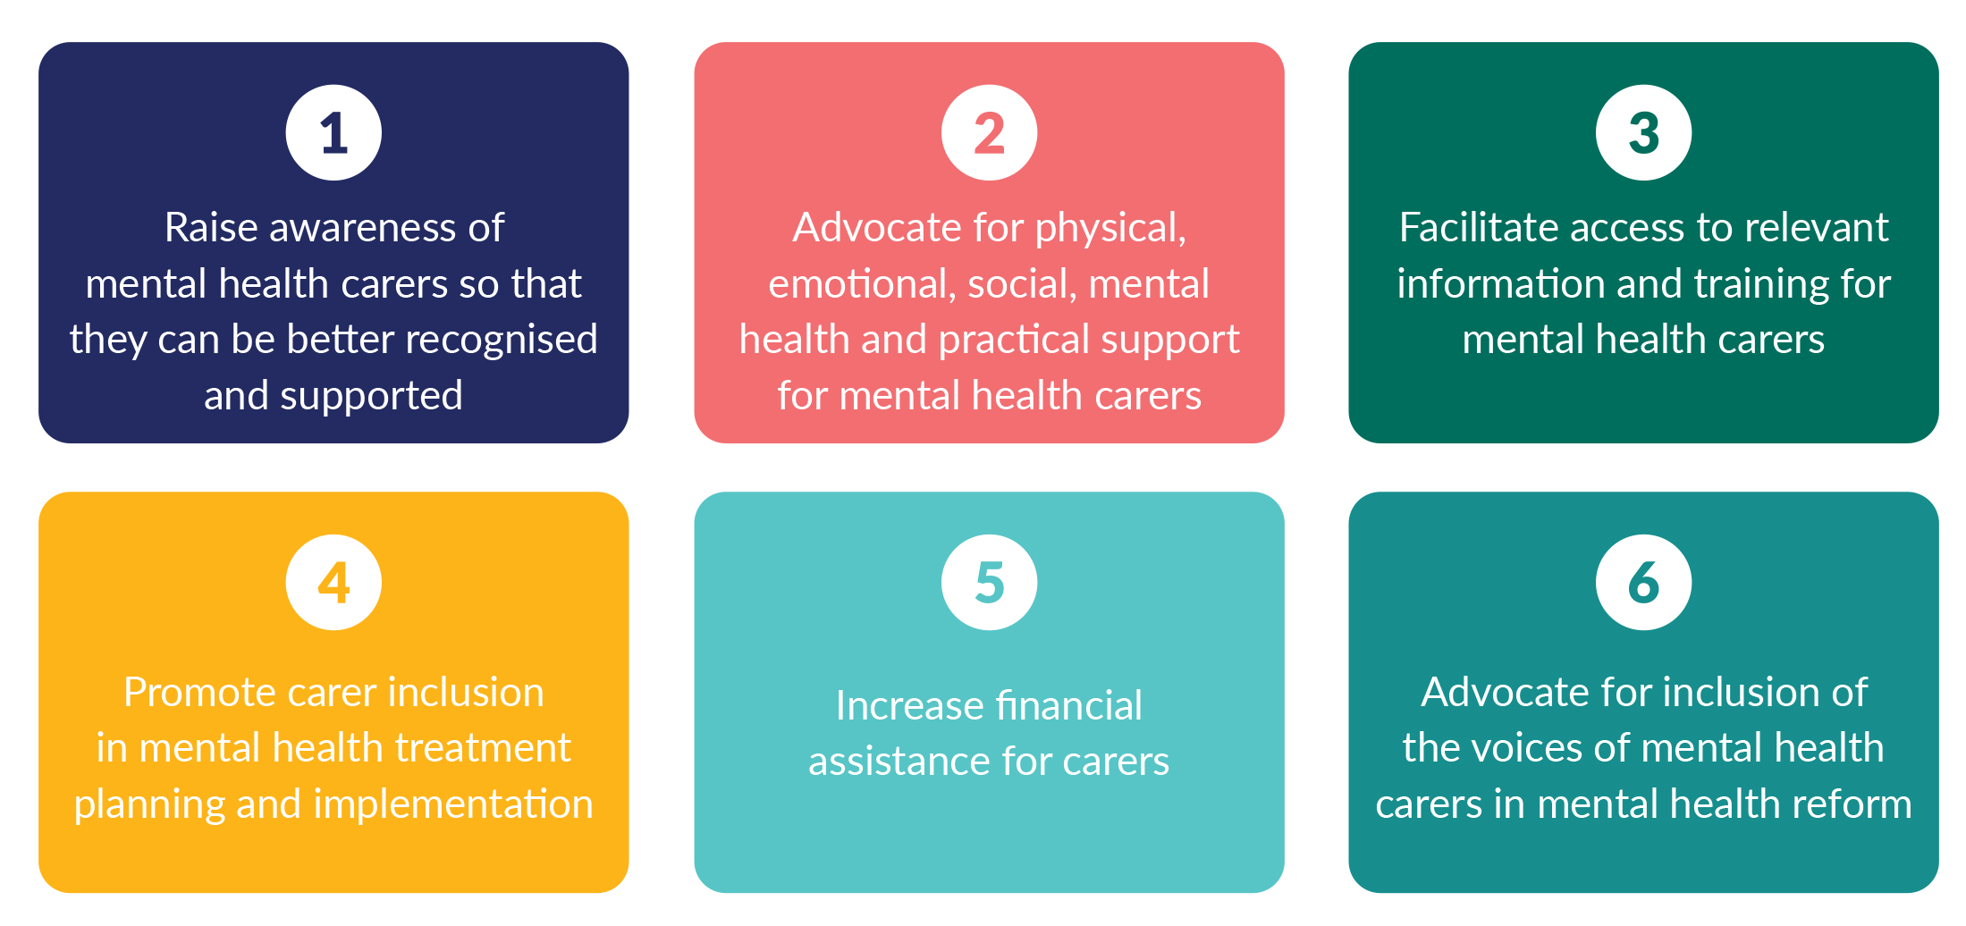
Areas for Action
Areas for action

Slide 10
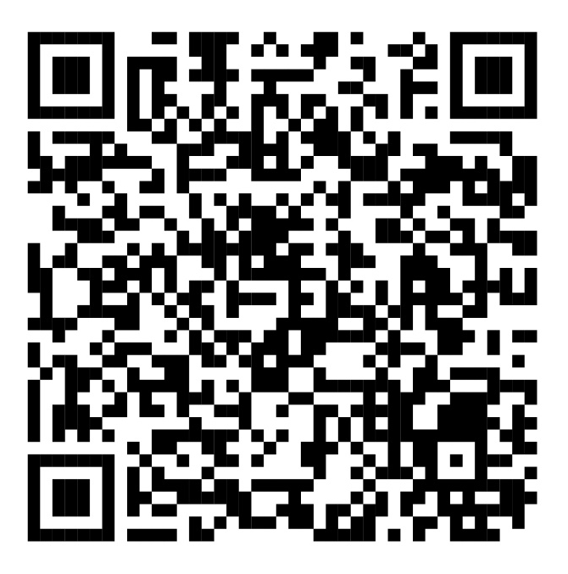
Download
At what cost?
Connect with us:
Carer Support Line - 1300 554 660
Website – www.arafmi.com.au
Advocacy team – advocacy@arafmi.com.au

